Slide 1
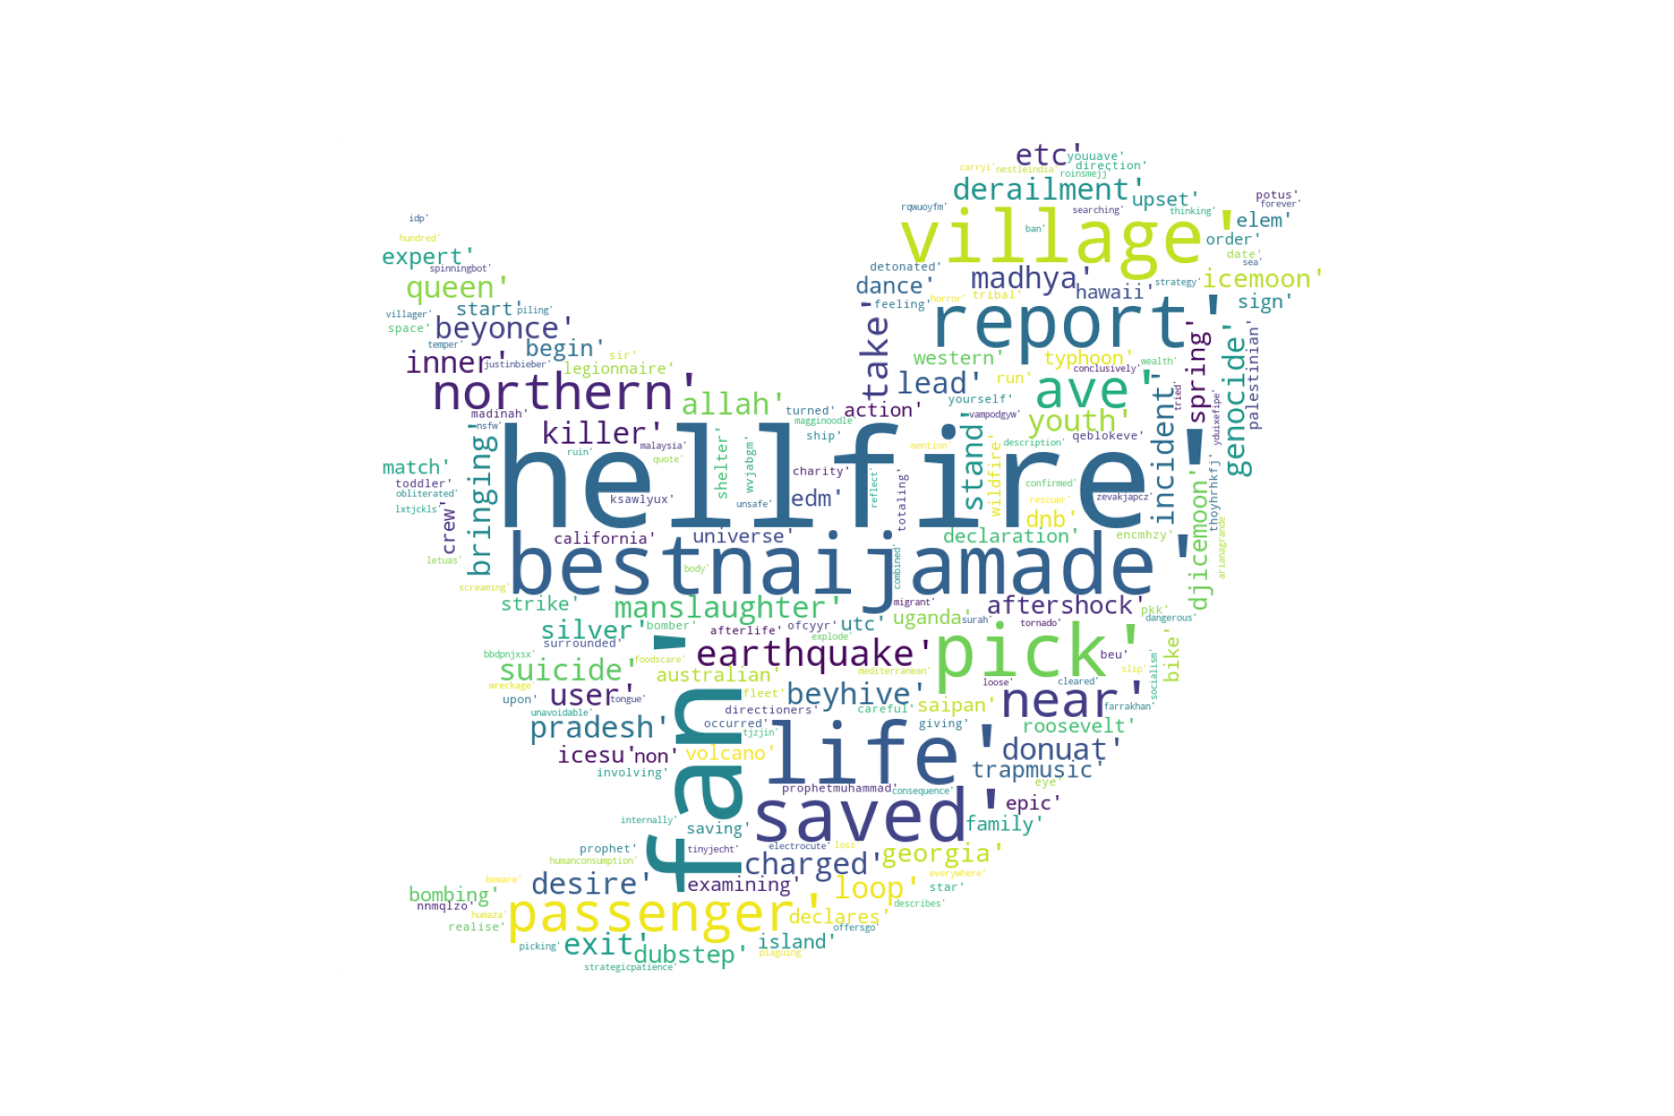
Binary Classification of Tweets
Indrani Banerjee

Slide 2
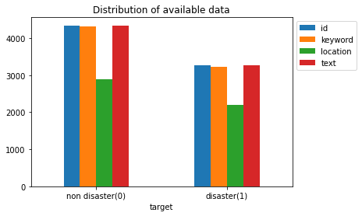
Distribution of data
Keywords
Location
Aim:

Slide 3
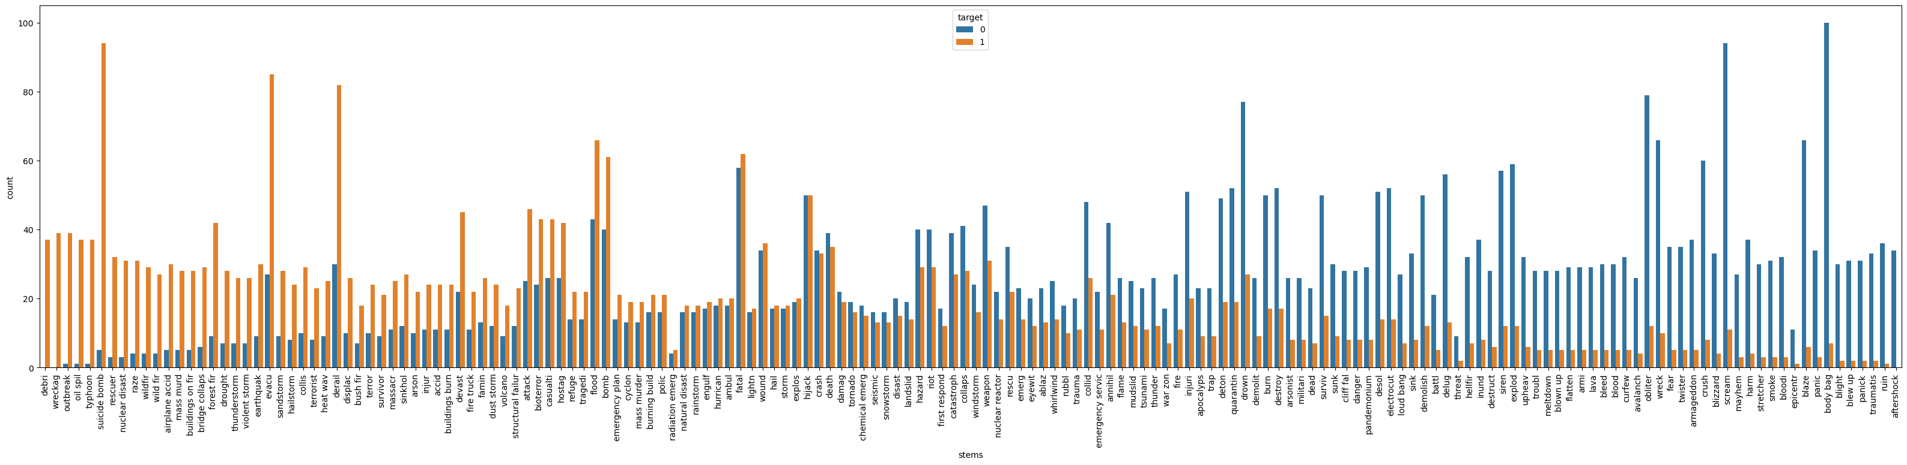

Slide 4
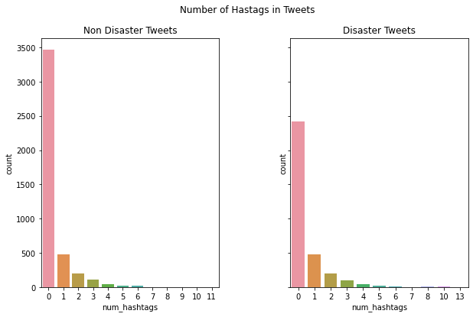
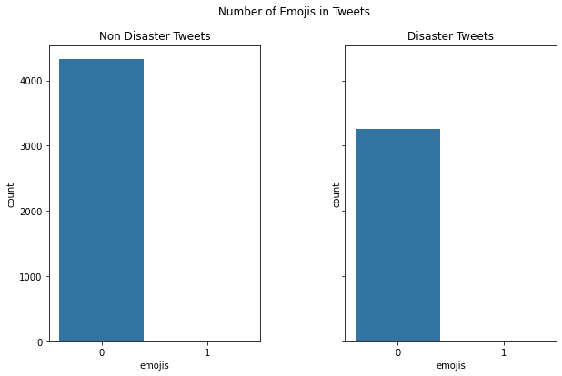

Slide 5
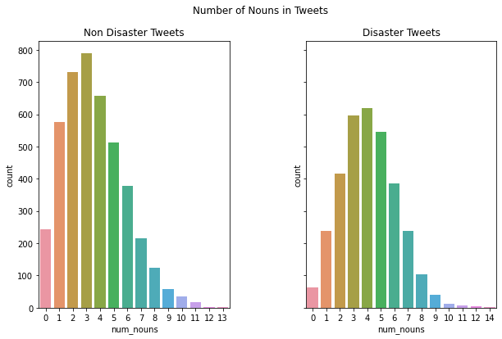
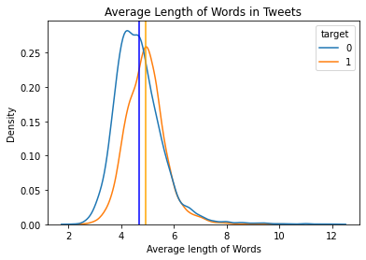

Slide 6
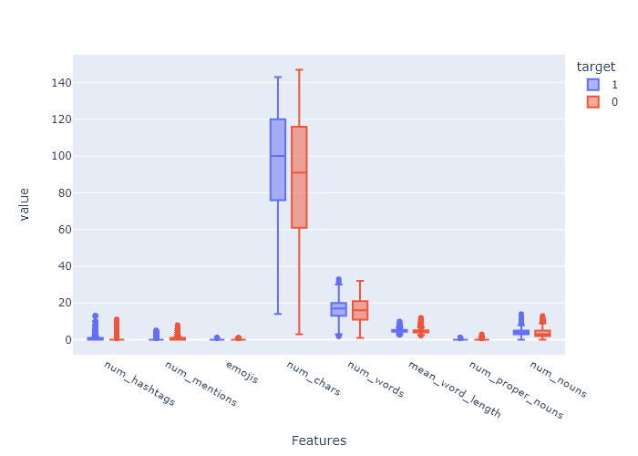
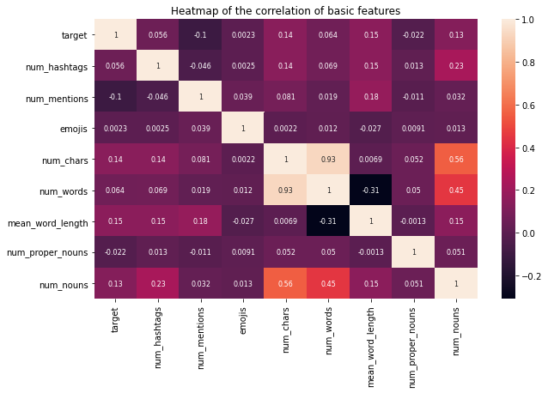

Slide 7
Classifier | Parameters | F1 Score | MCC | Accuracy | ROC_AUC | Recall
Logistic Regression | 'C': 10.0, 'penalty': 'l2', 'solver': 'liblinear | 0.75 | 0.58 | 0.79 | 0.78 | 0.68
Naive Bayes Classifier |  | 0.72 | 0.55 | 0.79 | 0.76 | 0.641
XGBoost | 'gamma': 2, 'learning_rate': 0.1, 'max_depth': 20, 'n_estimators': 20 | 0.52 | 0.44 | 0.70 | 0.67 | 0.36
Gradient Boosting Classifier | learning_rate': 0.2, 'max_depth': 8, 'n_estimators': 10 | 0.51 | 0.44 | 0.70 | 0.67 | 0.35
KNN | {'leaf_size': 1, 'n_neighbors': 1, 'p': 1} | 0.57 | 0.38 | 0.57 | 0.64 | 0.32
Random Forest | 'max_depth': 9, 'n_estimators': 5 | 0.29 | 0.30 | 0.62 | 0.58 | 0.17

Slide 8
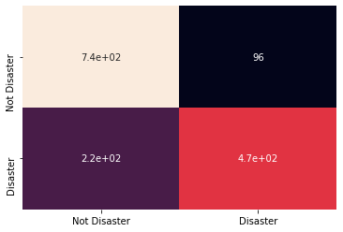
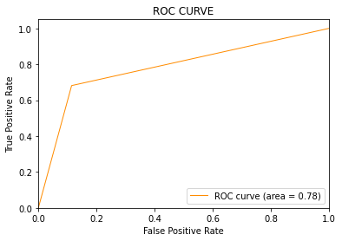
Logistic Regression

